Slide 1
Capstone Project -1
EDA on Airbnb bookings
By- Team Gladiator
Ankit Kumar Gupta
Ganta Praneeth Kumar
Rohit Bhat

Slide 2
Problem Statement
For this project we are analyzing Airbnb’s NYC data of 2019 . As we know NYC is the world’s greatest city and also has more attractions like Empire State Building, Museums, Sky scrappers etc.
Our main objective is to find the key metrics that influence the listings of properties.
We will be finding the distribution of Airbnb with density of listings on the map

Slide 3
Data Dictionary
Id- It provides a unique id to each listing in the dataset.
Name-It describes the property in a concise manner.
Host_id-It is used to ascertain the ownership of a certain individual
Host_name-It is the name of the property owner
Neighbourhood_group-It basically categorizes neighbourhood into five groups Bronx,Brooklyn,Manhattan,Staten Islands and Queens
Neighbourhood-It designates the location of a property.
Latitude-It Specifies the Latitude of the property.
Longitude-It denotes the Longitude of the property.
Room_type-It classifies the type of property into Private_Room,Shared_Room and Entire_Apartment

Slide 4
Data Dictionary
Price- It provides the price of each listed property.
Minimum_Nights-It gives the minimum night one needs to pay for in the property.
Number_of_reviews-It is used to ascertain the number of reviews received by a property.
Reviews_per_month-It denotes the number of reviews per month.
Calcuated_host_listings_count-It corresponds to the number of properties hosted by the unique host_id
Availability_365-The number of days the property is available in a year.
Last_review- The last day of review given

Slide 5
Agenda
Top 10 host id with most number of listings ?
Which neighbourhood_group has most number of listings?
Which room types people prefer in each neighbourhood_group?
Find the average price in every neighbourhood_group with respective to room type?
What is the maximum , minimum for each neighbourhood_group ?
Most Expensive host with less availability ?
Top 10 host with high profit ?
Total no. of nights spend per room types ?
Most Expensive hosts in neighbourhood_group which are suitable for business meeting?
Which quarter has most number of listings ?

Slide 6
Agenda
11. Which quarter has most avg number of reviews?
12. what is the average availability in each Quarter with respective neighbourhood_group ?
13. which quarter have the highest profits earned?
14. list out the most expensive host for each quarter?
15. Find out the correlation between the features?
16. find which part of NYC has more number of listings and their geographical advantages?

Slide 7
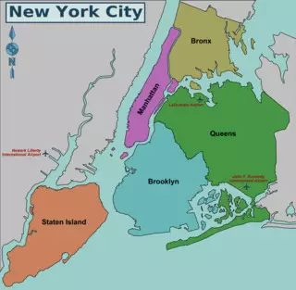
NYC MAP

Slide 8
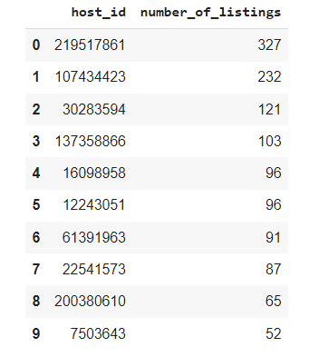
Top 10 host id with most number of listings ?

Slide 9
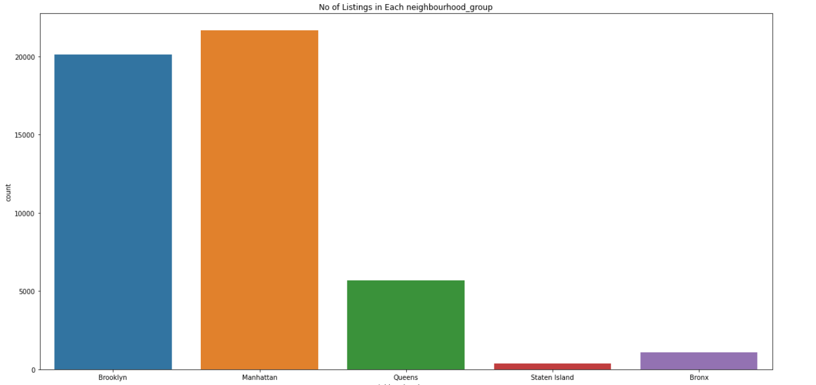
2 . Which neighbourhood_group has most number of listings?

Slide 10
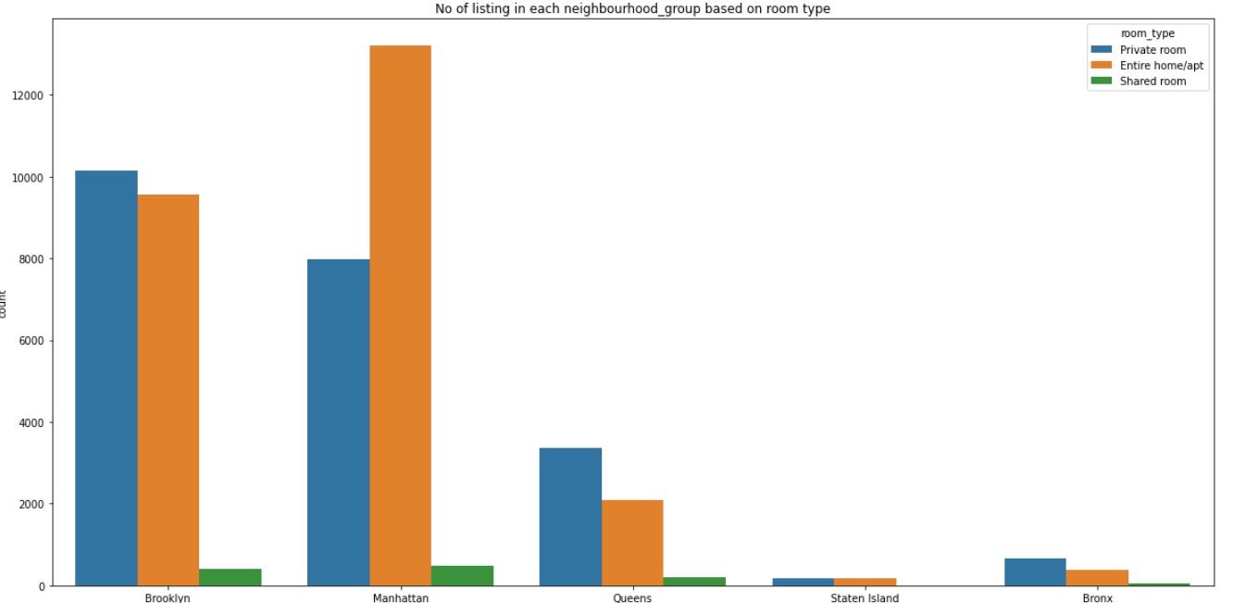
3. Which room types people prefer in each neighbourhood_group?

Slide 11
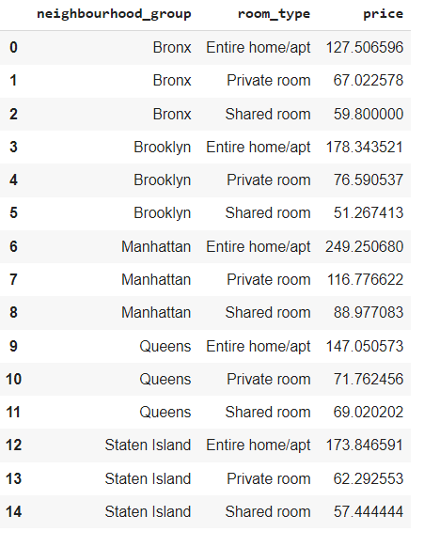
4 .Find the average price in every neighbourhood_group with respective to room type?

Slide 12
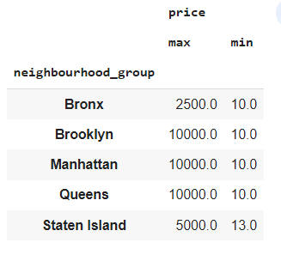
5.What is the maximum , minimum price for each neighbourhood_group ?

Slide 13
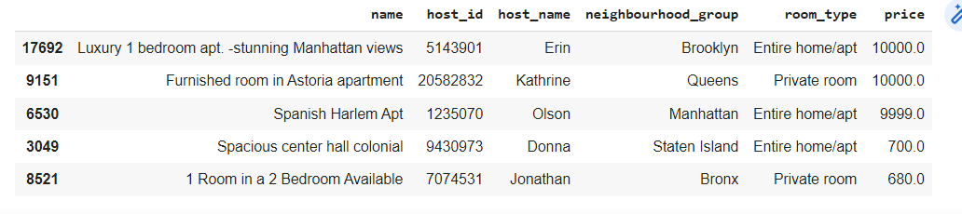
6. Most Expensive host with less availability ?

Slide 14
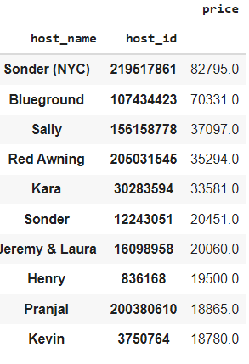
7. Top 10 host with high profit ?

Slide 15
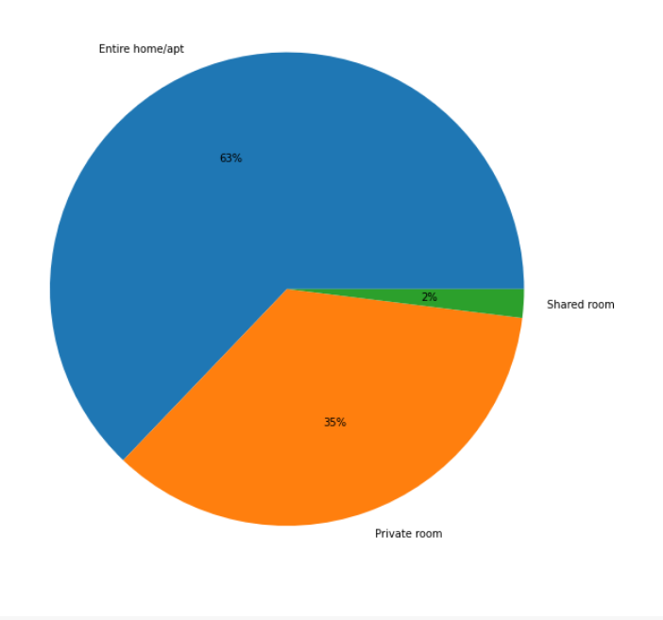
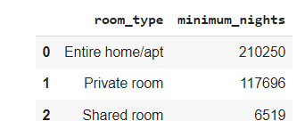
8.Total no. of nights spend per room types ?

Slide 16
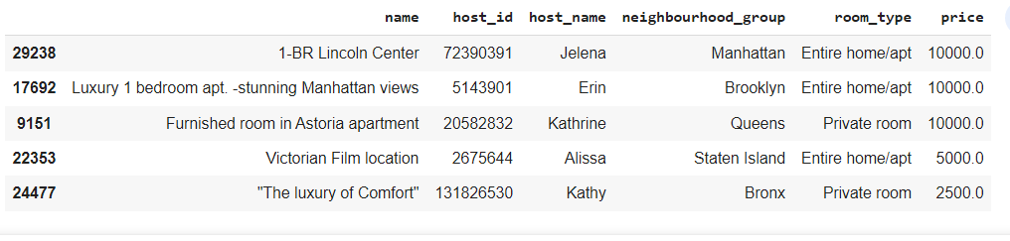
9. Most Expensive hosts in neighbourhood_group which are suitable for business meeting?

Slide 17
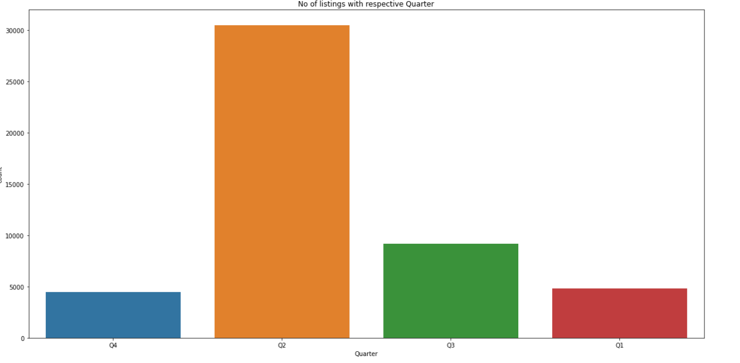
10 . Which quarter has most number of listings ?

Slide 18
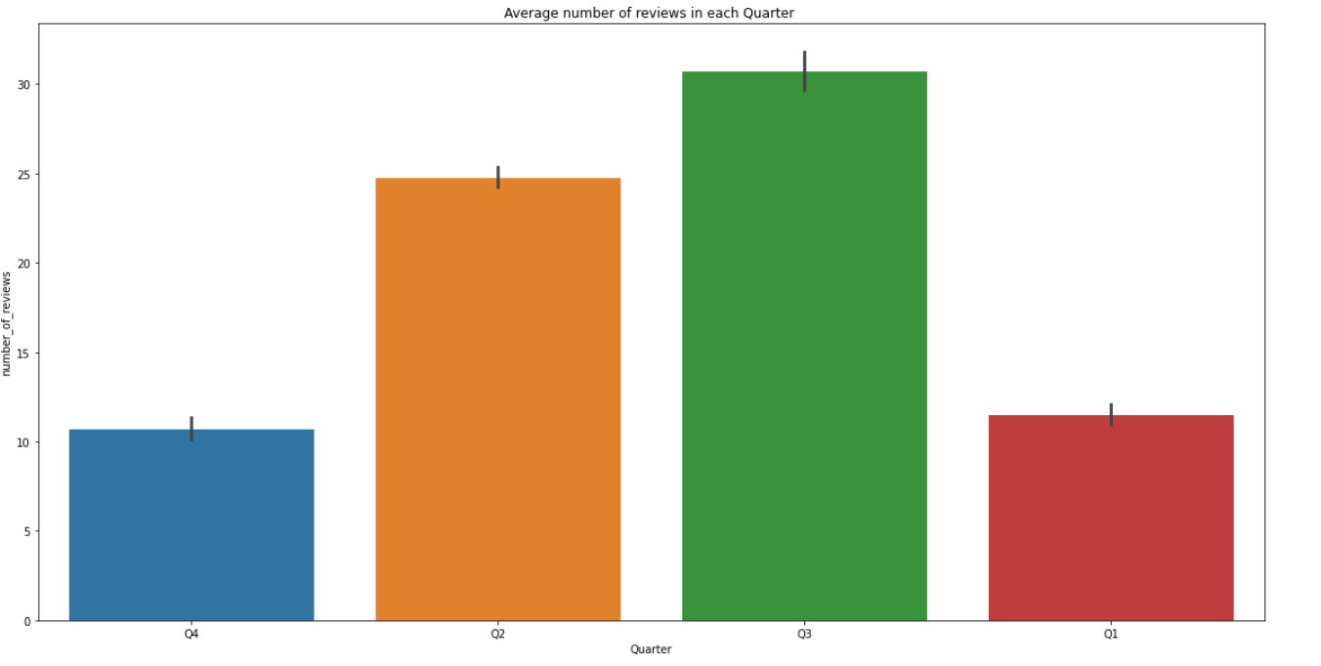
12. Which quarter has most avg number of reviews?

Slide 19
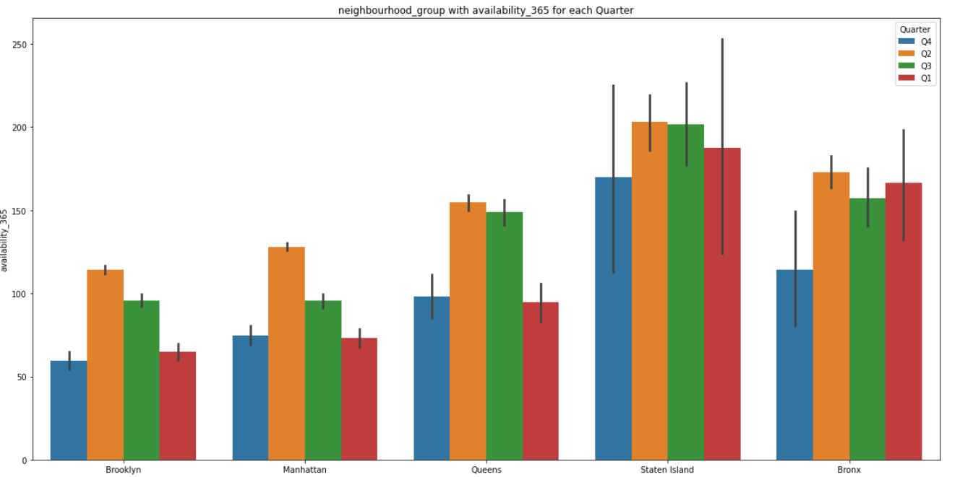
13.What is the average availability in each Quarter with respective neighbourhood_group

Slide 20
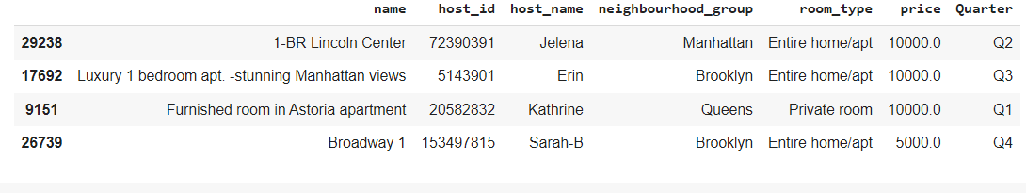
14. list out the most expensive host for each quarter?

Slide 21
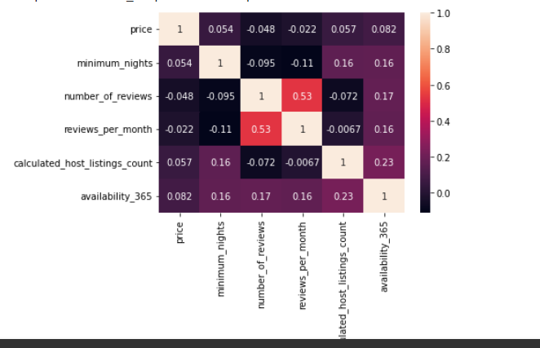
15. Find out the correlation between the features?

Slide 22
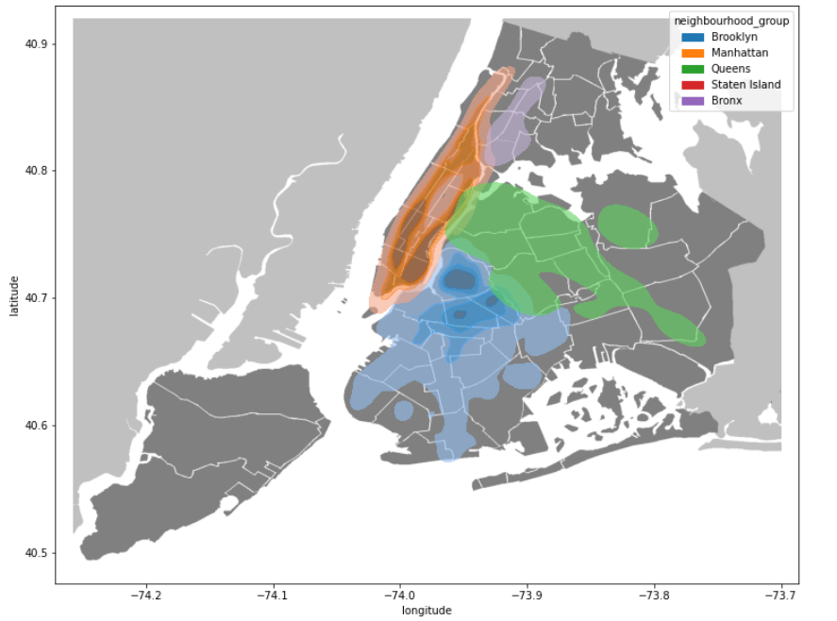
16. find which part of NYC has more number of listings and their geographical advantages?

Slide 23
Conclusion
Most visitors don’t prefer shared rooms, they tend to visit private rooms or the entire home.
Manhattan and Brooklyn are the two distinguished, expensive & posh areas of New York City.
Most People Prefer Quarter 2 to visit New York City among all Quarters.
The average availability of hosts in Manhattan and Brooklyn is very low compared to Other parts of city in all the Quarter
Some properties have Minimum Nights to stay more than 365 Days which can be favorable among Students, Low-Income Employees & Immigrants.
The hosts with Manhattan views and Central Park surrounding hosts are in high Demand
Though location of property has high relation on deciding its price, a property in a popular location doesn’t mean it will stay occupied most of the time.
It’d be better if we had avg guest ratings of a property, that would be beneficial in understanding the property more and could also be a factor in deciding price. A low rated property tends to lower their price.
Manhattan has the highest average price for all three room types compared with others . So we can say Manhattan is the most expensive area in New York City.

